Slide 1
ICU PATIENT MONITOR
Kuye Doluwamu Taiwo

Slide 2
Problem
Doctors cannot constantly be present in the intensive care unit, nor can they visit and monitor every patient at the same time; as a result, while attending to one patient, another may experience an emergency. Patients may experience difficulties as a result of this, and clinicians could feel helpless in the situation. The patient monitoring device provides a solution to these issues by continuously displaying vitals and alerting the doctor if any anomalous readings are detected.

Slide 3
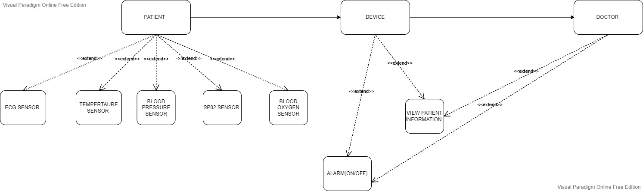
Diagram of the system elements

Slide 4
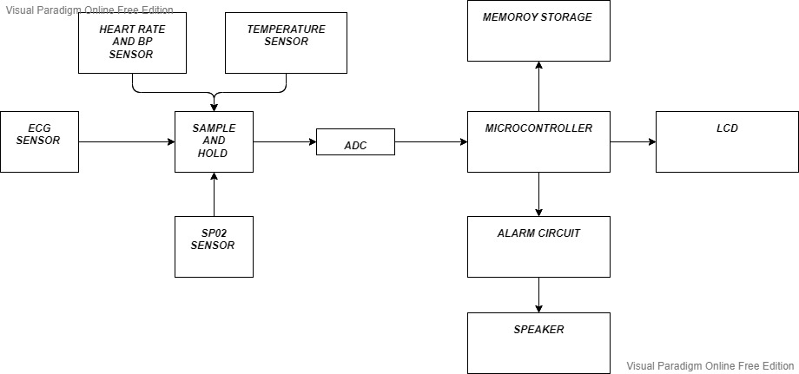
System block diagram

Slide 5
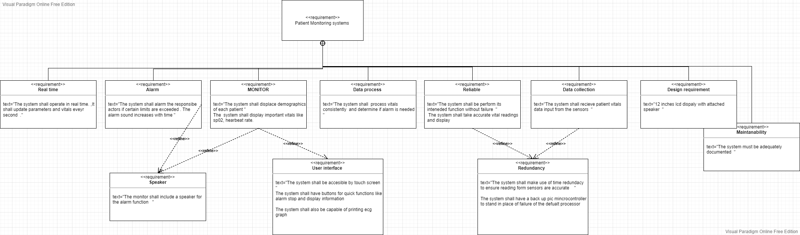
Requirements

Slide 6
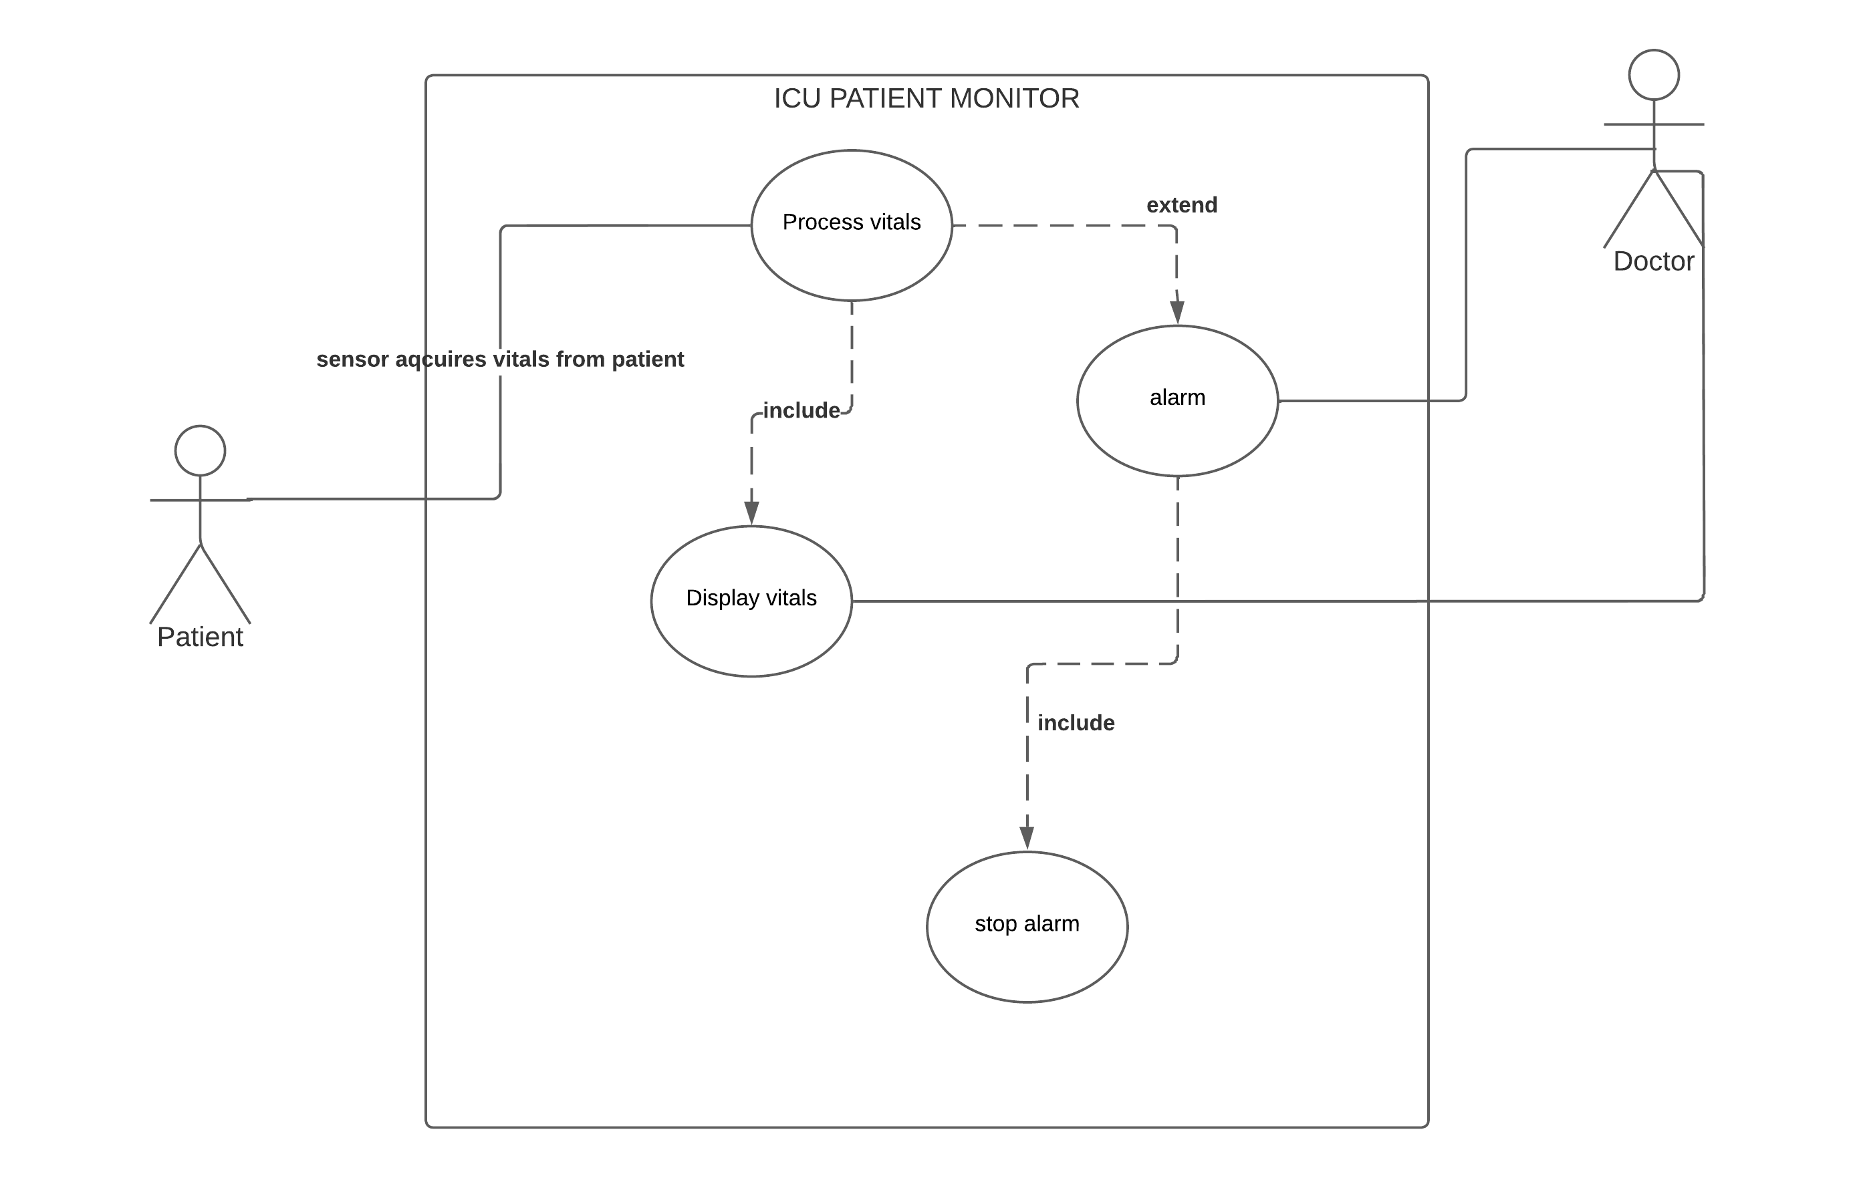
Use case

Slide 7
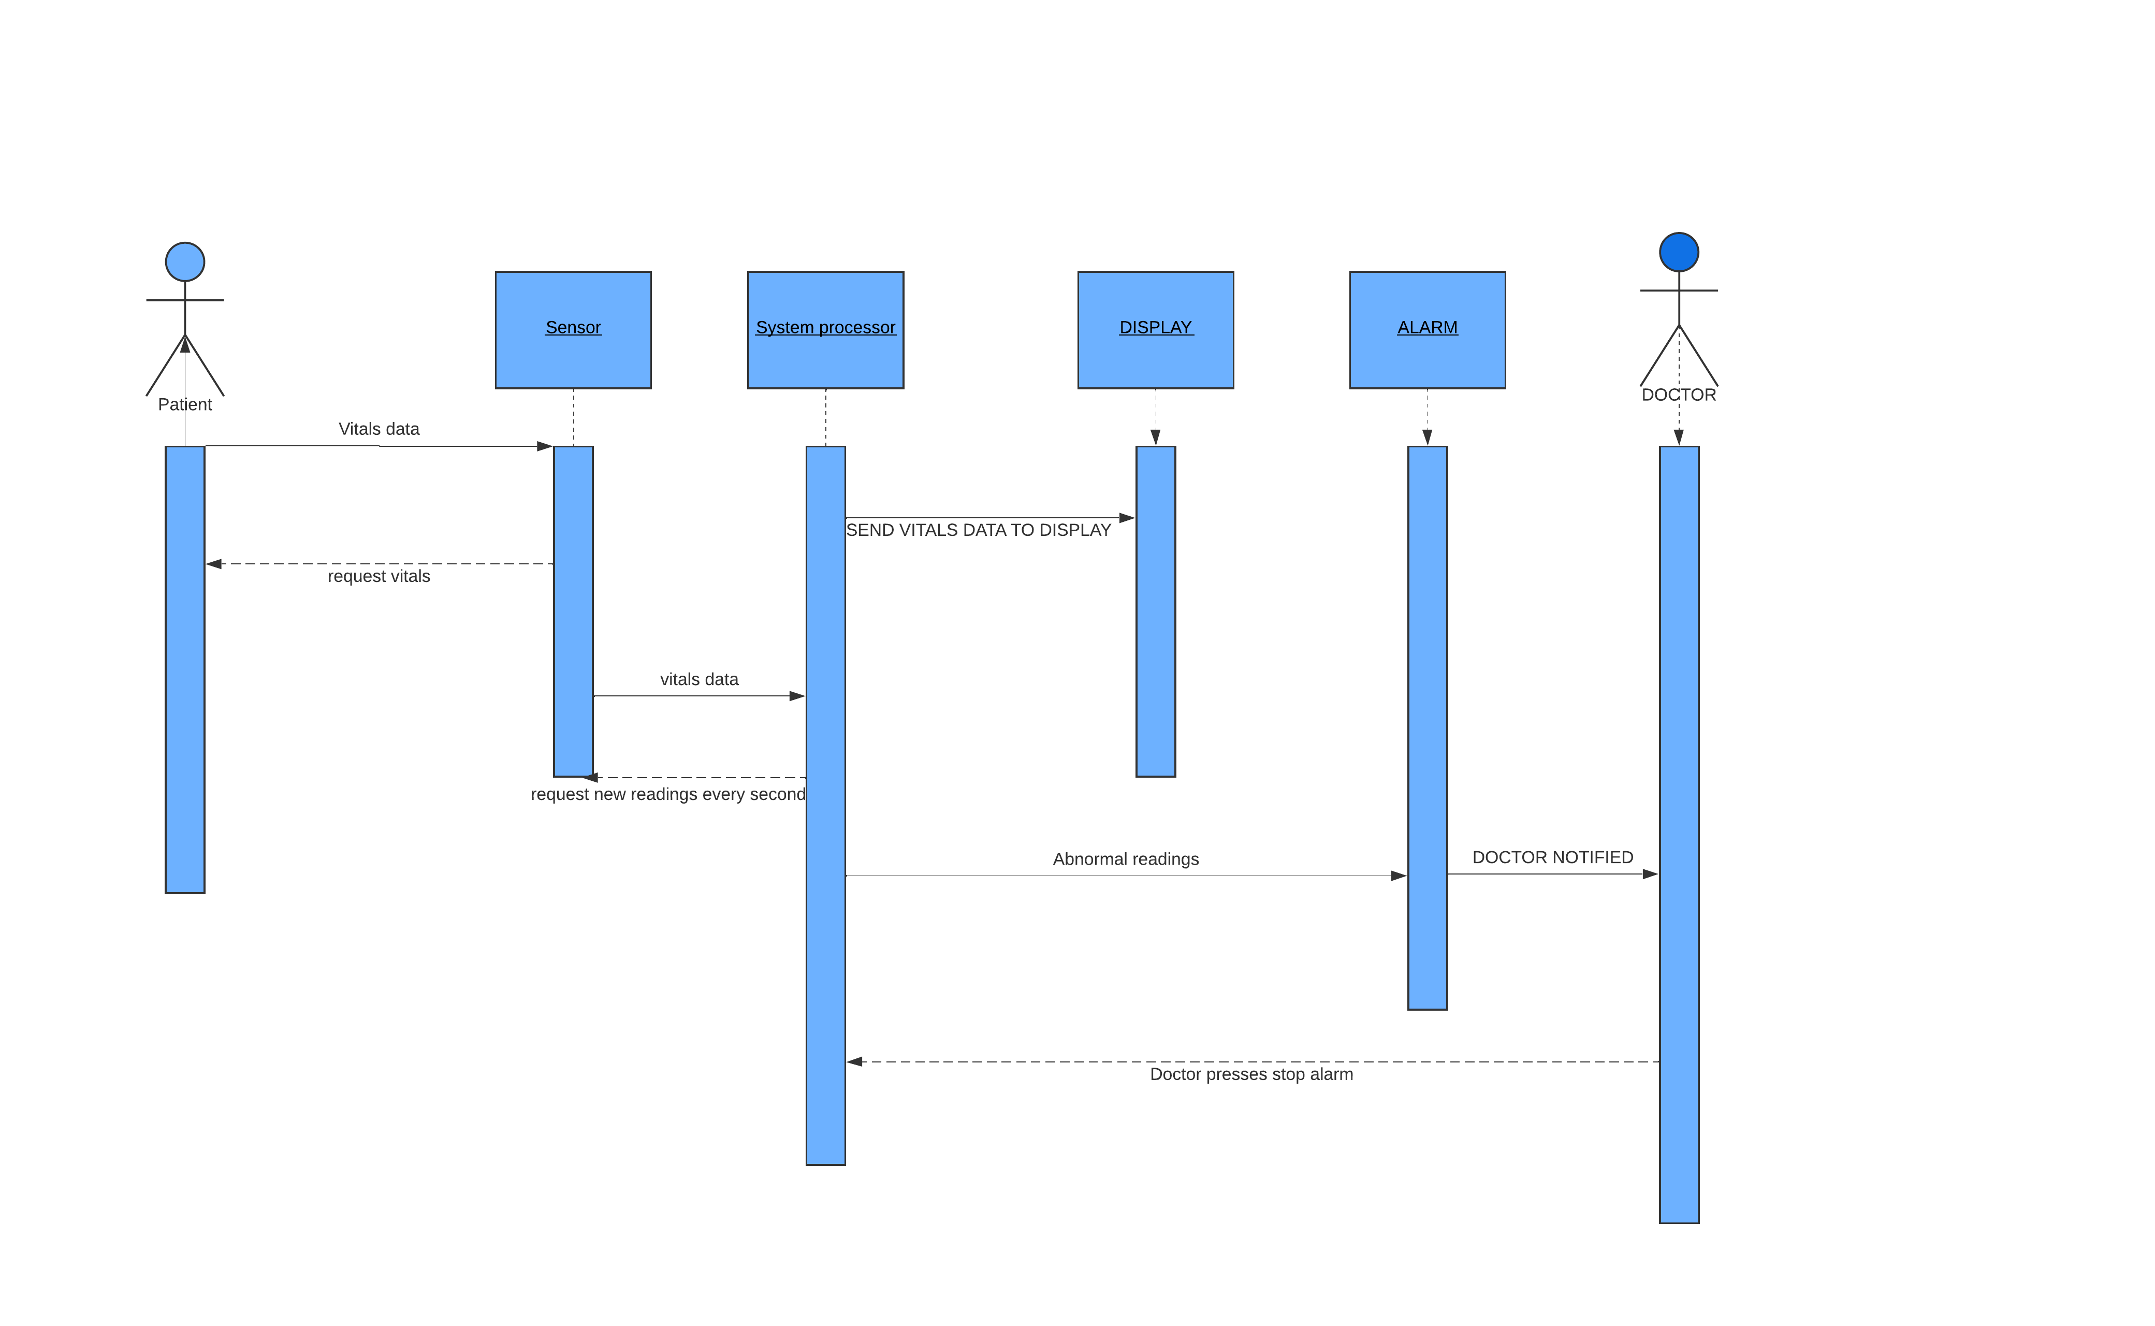
SEQUENCE DIAGRAM

Slide 8
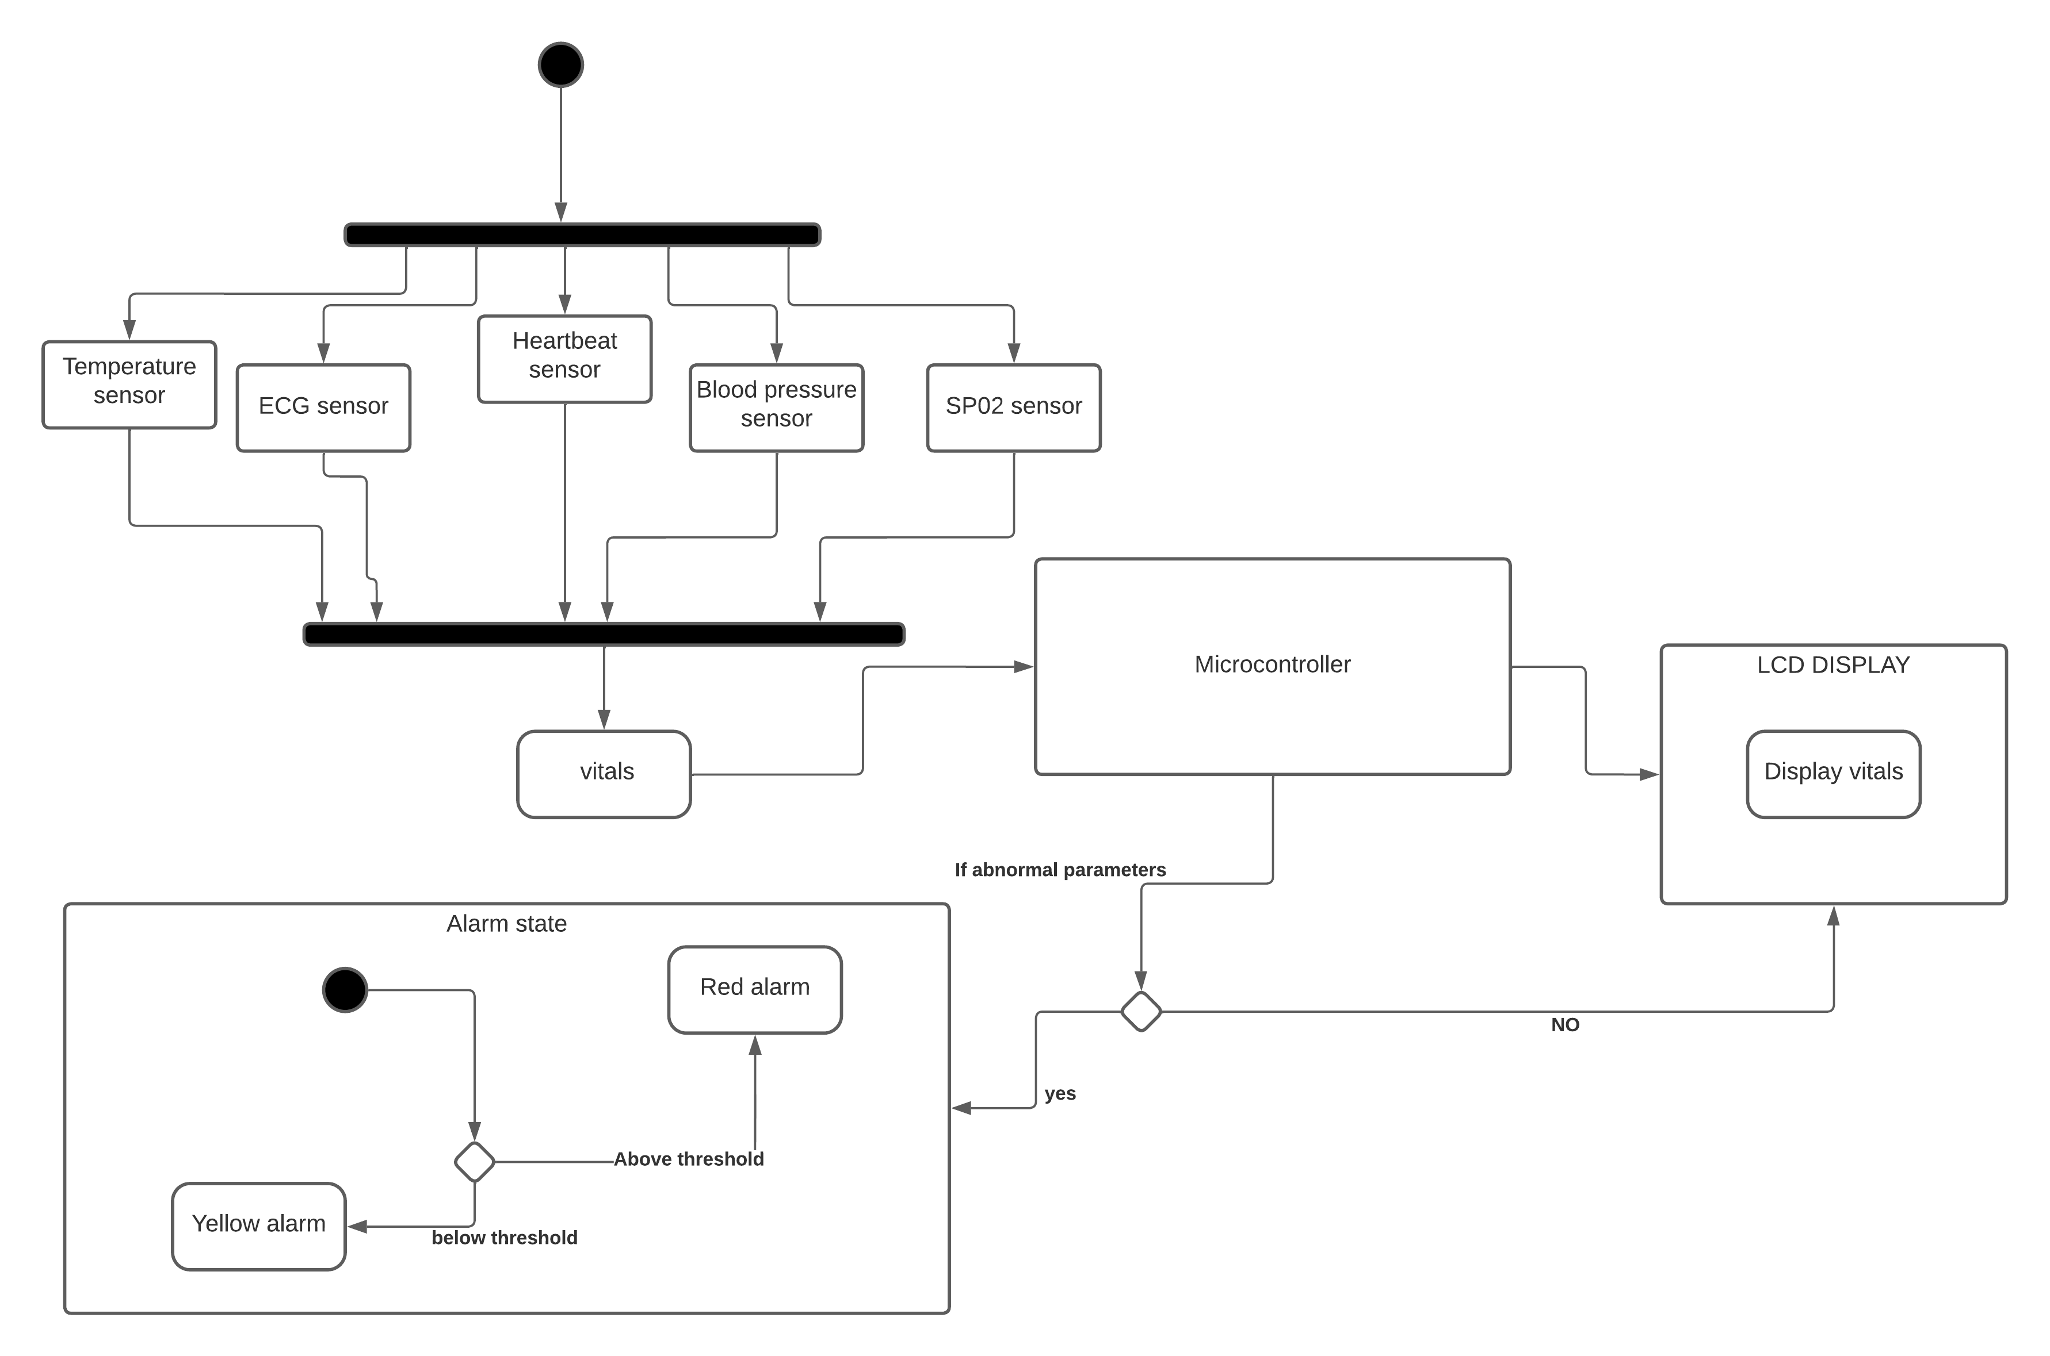
ACTIVITY DIAGRAM

Slide 9
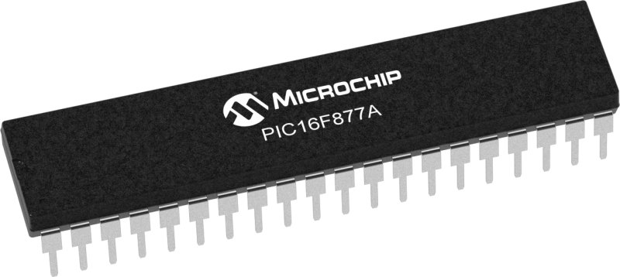
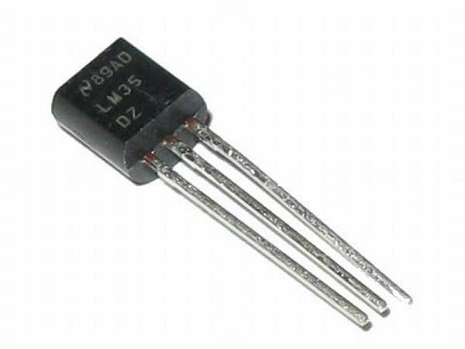
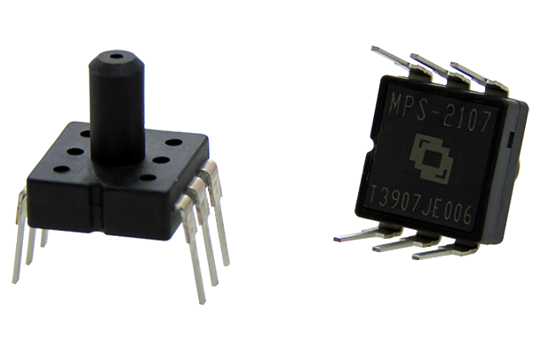
Hardware specification
MAX30102
ECG SENSOR
PIC16F877A
LM35
MPS2107

Slide 10
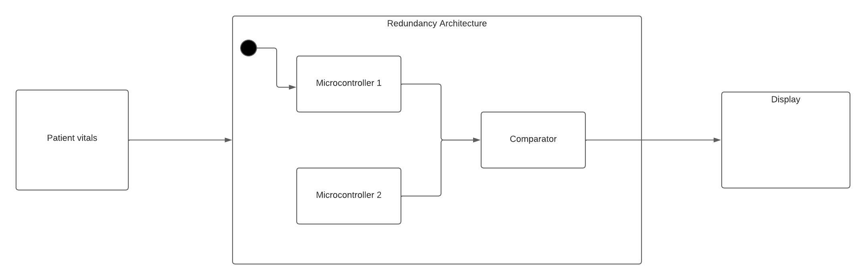
Critical part

Slide 11
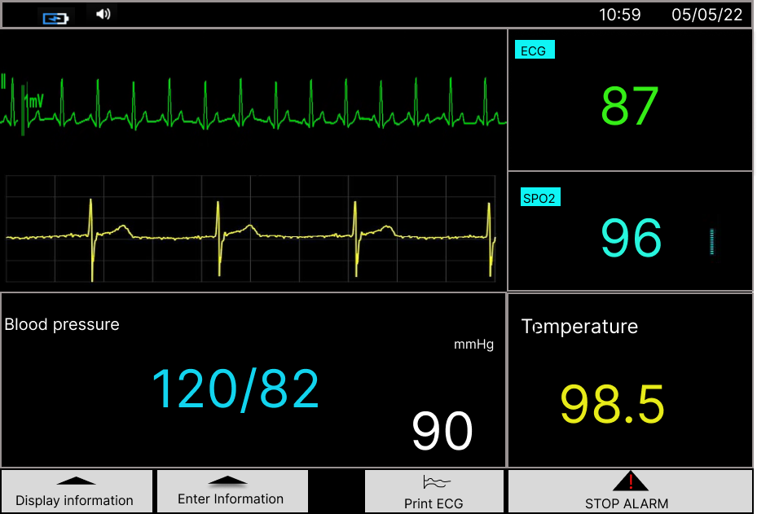
User interface (default screen)

Slide 12
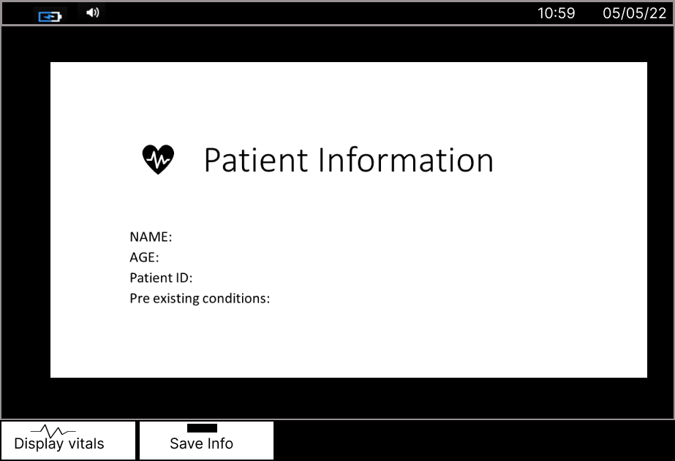
User interface (enter info screen)

Slide 13
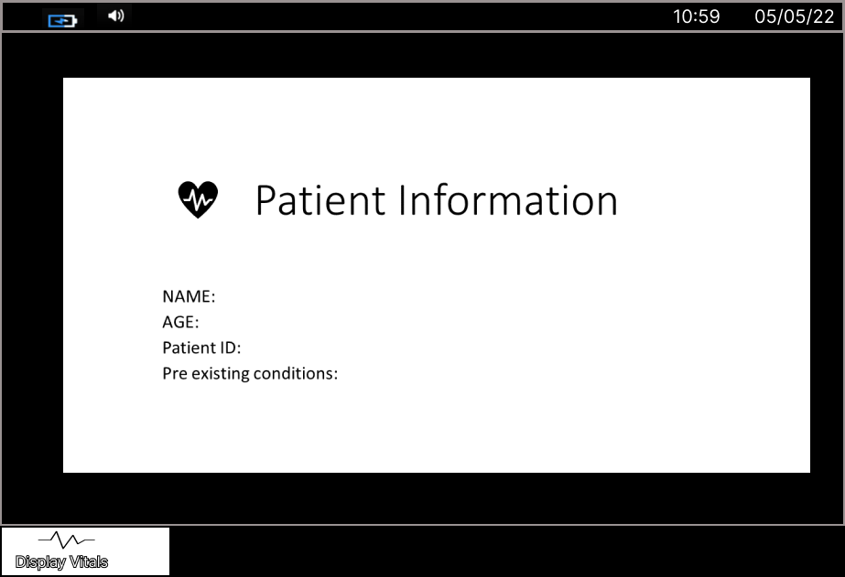
User interface (display info screen)

Slide 14
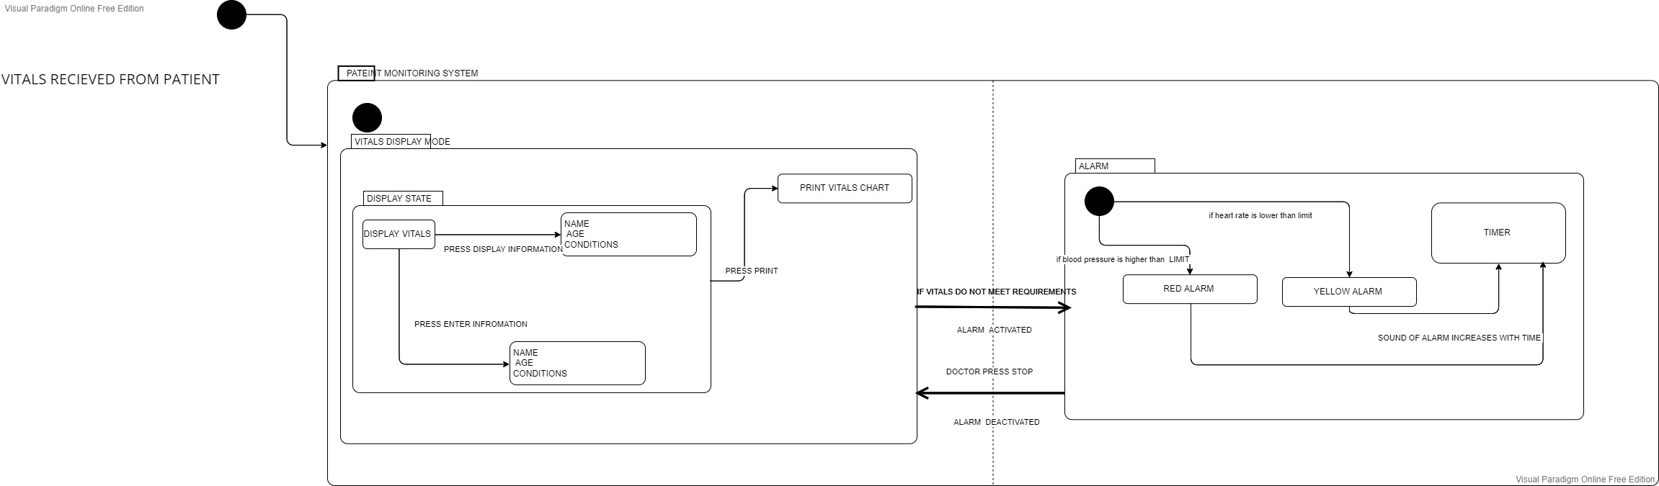
User interaction

Slide 15
Conclusion
By using the system, the healthcare professionals can monitor, and quickly diagnose ICU patients all the time.

